Slide 1
September Meeting
Team Meeting & 700 Governors Drive
9-19-2024 10:00 AM

Slide 2
Agenda
10:00 AM Call Meeting to Order-
Roll Call of Members- Secretary
Additional Items to be added to agenda – Please welcome BIT’s new commissioner, Dr. Madhu Gottumukkalla
Approve meeting minutes of June meeting
Organizations
Police Chiefs Assn. – Jason Jones
Sheriff’s Assn – Steve Swenson
DCI/Attorney General – Chad Mosteller
GFP – Bruce Nachtigall
DOT – Brian Wacholz
National Guard – David Goodwin
Emergency Managers – Pat Harrington
Firefighters – Charlie Kludt
Healthcare – Tim Rave
Highway Patrol – Micheal Peterson
APCO/NENA – Kevin Karley
EMT – Brent Long
Wildland Fire – Ray Black
County Commissioners – Kade Haley
Health Department – Chuck Kevghas
Tribal Governments – Jim Pearson
Federal Government – Andy Barth
BIT Engineering – Trent Nincehelser
SD Senate – Vacant
SD House of Representatives – David Kull
911 – Jason Husby

Slide 3
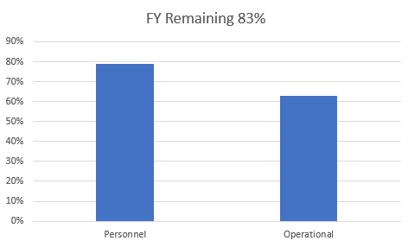
Old Business
Budget
Nearly 22% of total operational budget is paid in July for annual Motorola support contract
79% Personnel and 63% of Operational funds available

Slide 4
Old Business (Continued)
2. Broadband Subcommittee Report
FirstNet Buildout Updates
Critical Connect/ePTT services now live
3. Meade County I90 Corridor update
$46,000 funding appropriated for radio coverage study
Finalized contract with RFCC
Initial scope defined
Integrate needs for Rally operations
Determine next steps pending study results
Meade County reported good results with Siyata SD7 cellular devices
HP using SmartConnect with great success
4. Minnehaha County Project updates
North Minnehaha Simulcast anticipated completion Q1 2025
5.Organization Representative Vacancies
SD Senate
Highway Patrol – Vice Chair (pending appointment) Thank you to Lt. Garrett Wellman for service to the SDPSCC! Welcome Lt. Micheal Peterson!

Slide 5
New Business
1. SWIC Updates – Todd Dravland (SWIC South Dakota)
2. ACD Telecom, Ali Shahnami - presentation regarding FCC 4.9 GHz band proposal - FCC proposes to allow “secondary, non-public safety use as agreed to by public safety licensees” on the 4.9 GHz band. They also propose a nationwide Band Manager (“BM”) to coordinate all operations in the band and ensure public safety (“P.S.”) use remains predominant. Per FCC, the BM will be selected based on “expertise and connections to the public safety community”.
3. Bridge4PS presentation and update – Niki Papazoglakis
SDGFP onboard all LE officers
State Radio will be using for notifications very soon

Slide 6
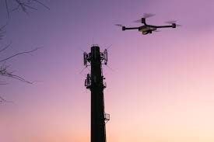
New Business (continued)
4. Drone Tower Inspection program
Physical tower inspections are costly and subject to human error
4 state radio technicians currently pursuing FAA part 107 licensing
Researching software platforms for creating digital twins of towers
5. Annual Sturgis Motorcycle Rally Debrief
Presented to stakeholders in Meade County August 28th
Planning for 85th
Expanding Sturgis State Radio site with EOY funds

Slide 7
New Business (continued)
72.86 Hours total airtime amongst top 10 Talkgroups in 2024
28.04 hours of total airtime amongst top 10 Talkgroups in 2023
Total airtime increase of 260% between 2023 and 2024
38.38 hours total airtime first three days of 2024 Rally
11.05 hours total airtime first three days of 2023 Rally
Total airtime increase 347% between 2023 and 2024
Sturgis PD1 drastically decreased usage on this talkgroup after day 3
Although there was significant congestion the trunked system handled the traffic much more efficiently than the conventional channels could have.
Now What? We do not have 30 op direct connected PSAP or simulcast systems at our disposal to solve this problem like larger communities.
No silver bullet approach – making tactical changes and impactful additions, will make a big difference.
Get creative, use new technology, expand channel resources at Sturgis site, interagency communication, planning, testing, coordination, and deployment – we will need to put a significant amount of planning together to handle the traffic for the Rally with the resources we have and adding resources that give us the most “bang for the buck”.

Slide 8
Top Ten Talkgroups used on Sturgis site during 2024 Rally August 2-11, 2024

Slide 9
Busied seconds on the Sturgis Tower during Rally
BE ADVISED! Circumstance where user keys up on a site that is fully utilized. As all resources are in use, radio system puts the user in a "queue" or waiting line for the first open resource. User will first hear the "busy" signal followed by a chirp when a resource is available to transmit on. If system is extremely busy, each additional keying of the push-to-talk button will reset the user to the bottom of the queue.

Slide 10
Number of PTTs per hour during 2024 Rally

Slide 11
Sturgis site use summary during 2024 Rally

Slide 12
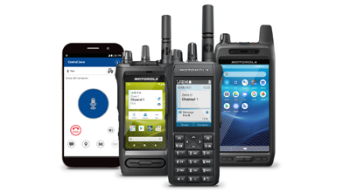
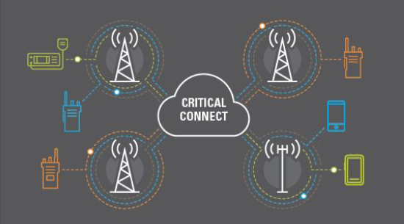
Critical Connect
Legacy interoperability solutions take a significant amount of time to set up and provision, requiring a separate interface for each agency connected. Critical Connect from Motorola Solutions fills this void by providing cloud-based interoperability between land mobile radio (LMR) systems, broadband PTT, and applications to eliminate barriers and unify communications for all responders.
Potential use case: cache accounts from State Radio to call in VIN #, Parking violations, towing, NCIC checks, and other non-emergent conversations that take a lot of airtime to complete.
Monitor and talk on Talkgroups outside of geofence.
Need phone numbers of users prior to the Rally to activate cache accounts.
Devices - Siyatas, PTT smartphone apps, TLK110, Sonim
Cost effective efficiently moving radio traffic across cellular towers – only for use with talkgroups that are geofenced from RF tower site. Using this technology on the same talkgroups as we are using for RF is not increasing efficiency.

Slide 13
SmartConnect
SmartConnect allows your radio to maintain voice communication when LMR is out of range by switching to a Wi-Fi, LTE, or satellite network.
INDOOR COVERAGE Radio coverage can become spotty deep inside large buildings – including office buildings, schools, and hospitals. With SmartConnect, first responders can leverage broadband LTE to maintain coverage when responding to incidents – keeping them safe and connected.
DEADSPOT MITIGATION While LMR systems are designed to provide the best coverage possible, there is always a possibility of a “dead spot.” SmartConnect enables first responders to seamlessly transition to broadband LTE – bridging coverage and maintaining connectivity.
NATIONWIDE COVERAGE Sometimes first responders are called to assist with a mutual aid incident or travel beyond their agency borders. Using LTE, SmartConnect allows them to connect back to their home dispatcher. First responders are now able to react faster and use network resources more efficiently.
Potential use case: Replace a couple of dispatch donor radios with Radios that support SmartConnect to communicate with geofenced talkgroups outside of Sturgis such as Faith and Rapid CIty. Use in concert with DVRS to create non-RF impacting talkgroups while still allowing users in the field to scan mission-critical talkgroups.
Department of Health recently replaced radios in ambulances that can utilize SmartConnect. This would be extremely helpful when talking to Rapid City Talkgroups.
Can be preferred to Wifi Operation to take load off RF system, again only for use with talkgroups that are geofenced from RF tower site. Using this technology on the same talkgroups as we are using for RF is not increasing efficiency.
SmartConnect Demo
COMPATABILITY
Portable radios:
• APX NEXT series via Wi-Fi or LTE
• APX 8000 series via Wi-Fi
• APX N70 via Wi-Fi or LTE
• APX N50 via Wi-Fi
• APX N30 via Wi-Fi
• APX 6000 enhanced series
(BN) via Wi-Fi
Mobile radios:
• APX 8500 via Wi-Fi or Data
Modem Tethering
• APX 6500 enhanced series
(BN/CN) via Wi-Fi or Data
Modem Tethering
Consolettes:
• APX All-Band Consolette

Slide 14
Sturgis/Meade County Conventional Channels
Use these resources for failover in the event of high congestion
Use for groups that do not need to hear others agency traffic

Slide 15
Organizational Reports
Organization Reports
Police Chiefs Assn. – Jason Jones
Sheriff’s Assn – Steve Swenson
DCI/Attorney General – Chad Mosteller
GFP – Bruce Nachtigall
DOT – Brian Wacholz
National Guard – David Goodwin
Emergency Managers – Pat Harrington
Firefighters – Charlie Kludt
Healthcare – Tim Rave
Highway Patrol – Micheal Peterson (interim)
APCO/NENA – Kevin Karley
EMT – Brent Long
Wildland Fire – Ray Black
County Commissioners – Kade Haley
Health Department – Chuck Kevghas
Tribal Governments – Jim Pearson
Federal Government – Andy Barth
BIT Engineering – Trent Nincehelser
SD Senate – Vacant
SD House of Representatives – David Kull
911 – Jason Husby
Closing Comments
Vice-chair –
Member at Large - Kevin Karley
Chair – Bruce Nachtigall
Next Meeting: date, time, location

